Slide 1

Socker: Network-application Co-programming with Socket Tracing
Dong Guo*, Shuhe Wang ⁺, Y. Richard Yang† ﻿
* Tongji University, ⁺ Tsinghua University, † Yale University
^{August 23, 2021 @ NAI’21}
Notes:
Hi everyone! I’m Dong Guo, a fourth-year PhD student from Tongji University. Today I’m going to introduce socker, a socker layer framework for network-application co-programming with socket tracing.

Slide 2



Background
Increasing demands for bi-directional awareness between applications and networks
Controller
Network context
Network functions (NF)
NF 1
NF 2
…
NF M
?
How to co-program NF/AF?
End-host context
Application functions (AF)
AF 1
AF 2
…
AF N
Notes:
Nowadays, there are increasing demands for bi-directional awareness between applications and networks. Specifically, $the Application functions, which we refer to as AF, are deployed at the end-hosts, and $the network control functions, which we refer to as NF, are deployed at the controller or the network devices of the network. $We want to co-program the NF and AF to achieve certain functionalities like network-aware routing or zero rating, however, The AF and NF are hard to co-program since they are running at different contexts. $How to co-program the NF and AF is still challenging.

Slide 3



Motivating Case
The client C sends data to the server S
MaxBWPath(100Mbps, 4hops)
Req2: Large files use MaxBWPath
100Mbps
100Mbps
Req3: Compress the data before sending, the compression level is computed by the bandwidth of the path
100Mbps
50Mbps
100Mbps
Client C
Server S
ShortestPath(50Mbps,3hops)
Req1: Real-time messages use ShortestPath
Notes:
Let’s start with a simple motivating case. Here we have a network with three switches and two end-hosts, the bandwidth of the links are marked on the figure. The client C sends data to the server S, such a scenario includes uploading files to FTP server or real-time video pushing. In this case, We have two paths from the client to the server, $one is the shortest path with fifty Mbps bandwidth and there hops, $another is the max bandwidth path with one hundred Mbps bandwidth and four hops. We want to achieve the following requirements. $For the real-time messages, we use the shortest path, $for large files, we use the max bandwidth path. $Also, we Compress the data before sending, and the compression level is computed by the bandwidth of the path.

Slide 4
Naïve Solutions -> Challenges
Pre-setup paths matching on the 5-tuples
The 5-tuples are the same for the single socket
The dynamicity of the parameters for socket creation (e.g., from remote database)
Use different sockets for the flows
The ephemeral ports are unknown
Setup paths after ephemeral ports are allocated
TCP handshake packets leak after connect() syscall
100Mbps
100Mbps
100Mbps
50Mbps
100Mbps
Client C
Server S
proto: 6
dstIP: S, srcIP: C
dstPort: 80, srcPort: 60000
Notes:
Achieving the above goal is not easy. Here we go over the naïve solutions to lead out the challenges. $One might think we can pre-setup the two paths by matching on the 5-tuple, however,$ as shown in the figure, the 5-tuple of the packets on different paths are the same when they are sent from the same socket, therefore the first switch cannot decide the egress port for the two packets. Also, the parameters of socket creation may be dynamically loaded, for example from a remote database, thus the match values cannot be decided before the application is executed. To tackle the problems, $we can use different sockets for the flows and distinguish the flows using the source ports of the transport layer. But, the source port is ephemeral [ɪˈfemərəl] which is dynamically allocated by the operating system and are unknown before execution. $So whether we can setup paths after the local ports are allocated? This works for data packets but the TCP handshake packets are out of control, since the current BSD TCP socket APIs returns the local port by the connect system call, which sends out the handshake packets already. $In addition, to achieve the state dependency between the AF and NF, we run them at the same end-host and they interact by direct function call, but this leads to strong coupling and hard to realize auto re-execution upon states change.

Slide 5
Naïve Solutions -> Challenges
Pre-setup paths matching on the 5-tuple
The 5-tuple are same for the single socket
The dynamicity of the parameters for socket creation (e.g., from remote database)
Use different sockets for the flows
The ephemeral ports are unknown
Setup paths after ephemeral ports are allocated
TCP handshake packets leak after connect() syscall
Challenge 1: Flow uncertainty
100Mbps
100Mbps
100Mbps
50Mbps
100Mbps
Client C
Server S
proto: 6
dstIP: S, srcIP: C
dstPort: 80, srcPort: 60000
Notes:
We sum up the above issues as the flow uncertainty challenge

Slide 6


Naïve Solutions -> Challenges
Directly call AF/NF as normal functions, pass states by arguments
State inconsistency
Hard to realize auto re-execution
s1
NF
s1'
s2
AF
s2'
s1
NF
s1'
s2
AF
s2*
Notes:
To achieve the state passing of the AF and NF, the naïve solution is to directly call them as normal functions and pass the states by arguments. but this may leads to state inconsistency. For example, $ the NF reads state s1 and update s1, the AF reads state s1 and s2 and update s2, if the AF is executed before the NF is returned, $we get the wrong value of s2 prime. $The correct process should be executing the AF again after s1 is updated, so that we can guarantee the consistency. In addition, the direct function call forms a strong coupling of the Af and NF, and hard to realize auto re-execution upon states change.
Reactivity.
State sync

Slide 7
Naïve Solutions -> Challenges
Challenge 2: AF/NF states dependency
Directly call AF/NF as normal functions, pass states by arguments
State inconsistency
Hard to realize auto re-execution
s1
NF
s1'
s2
AF
s2'
s1
NF
s1'
s2
AF
s2'
Notes:
Then we have another challenge, which we refer to as the AF and NF states dependency challenge

Slide 8
Q: What’s the solution of Socker?
Notes:
So how socker tackles above challenges?

Slide 9
Socker Solution
Challenge 1: Flow uncertainty
Tracing the sockets at run-time to obtain the flow attributes
Challenge 2: AF/NF states dependency
Use a shared data bus and provide pub/sub APIs for AF/NF states synchronization
Notes:
In high-level, $For the flow uncertainty challenge, socker traces the sockets at run-time to obtain the flow attributes. $For the AF/NF states dependency challenge, socker uses a shared data bus and provide pub/sub APIs for AF/NF states synchronization

Slide 10







Why We Trace the Socket?
Socket is the waist between applications and networks
Language independent
Global management
The emerging eBPF and kernel tracing techniques
Open the black-boxes of the system calls
High performance packet processing in kernel
Socket
TCP
RAW
UDP
Notes:
Why we choose the socket layer as the target to tracing? $$First, we observe that socket is the waist between the applications and networks, and sockets have a long-time tested and stable APIs provided by libc, tracing the sockets can achieve a language independent implementation and realize global management. $In addition, The emerging eBPF and kernel tracing technics open the black-boxes of the system calls, and easy to realize high performance packet processing guided by the attributes of sockets.

Slide 11
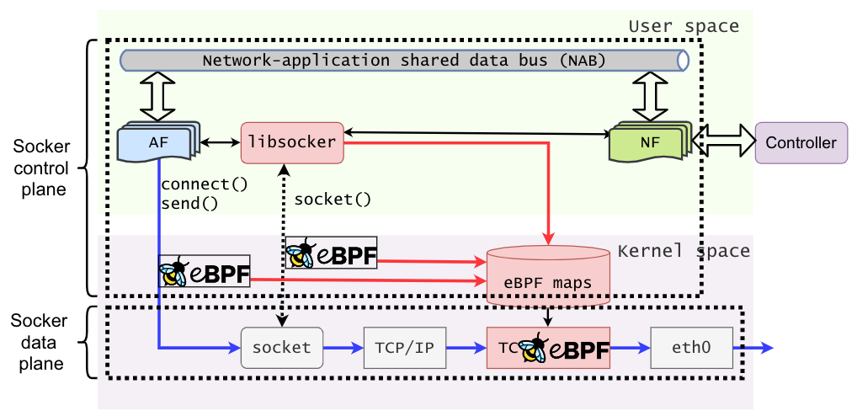
Socker Overview
Socker control plane
Network-application shared data bus (NAB): Provides a shared data bus between AF/NF, triggers re-execution automatically
Libsocker: A user space library that wraps the socket system calls
Socker data plane
eBPF maps: Stores the states of sockets
eBPF program: Traces socket system calls
and applies desired actions to out-bound
packets.
End-host
Notes:
Then we introduce the overall architecture of socker. Socker is deployed at end-hosts, and consists of a control plane and a data plane as shown in the figure. $$In the control plane, socker maintains a network-application shared data bus (NAB), which is a key-value data store running at the process scope. The AF and NF can read or write state variables to it, and NAB triggers the function re-execution when states changed. $$$ The libsocker is a user space library that wraps the conventional socket system calls. $$$ The data plane of socker is realized by eBPF, it maintains a set of eBPF maps to store the traced states of sockets, $ and a set of eBPF programs to trace the socket system calls or applies desired actions to out-bound packets at the egress of traffic control on the end-host.

Slide 12
Socker Overview
Designed for the AF/NF states dependency challenge
Socker control plane
Network-application shared data bus (NAB): Provides a shared data bus between AF/NF, triggers re-execution automatically
Libsocker: A user space library that wraps the socket system calls
Socker data plane
eBPF maps: Stores the states of sockets
eBPF program: Traces socket system calls
and applies desired actions to out-bound
packets.
Designed for the flow uncertainty challenge
End-host
Notes:
Overall, $the NAB is designed for solving the AF and NF state dependency challenge, $and other parts are designed for solving the flow uncertainty challenge.

Slide 13
Q: How to use Socker to do network-application co-programming?
Notes:
So, How to use Socker to do network-application co-programming

Slide 14
Socker APIs (Socket)
TCP socket APIs
UDP socket APIs
socker(nf, family, type)
connect(ip, port)
send(data)
recv(size)
close()
socker(nf, family, type)
send(data, ip, port)
recv(size)
close()
Allows the programmers to
specify a NF to a socket
Notes:
Socker provides two series of APIs, one is the socket APIs for TCP and UDP socket programming. They are similar to the conventional BSD style socket APIs, $except that socker allows the programmers to specify a network function when creating a socket.

Slide 15
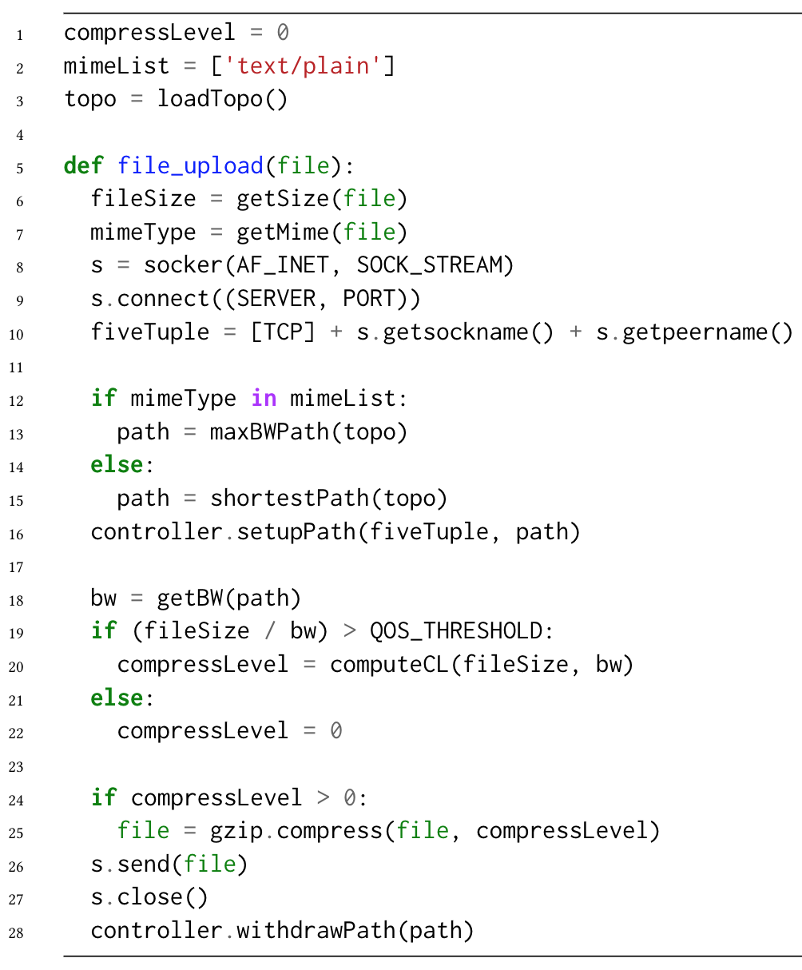
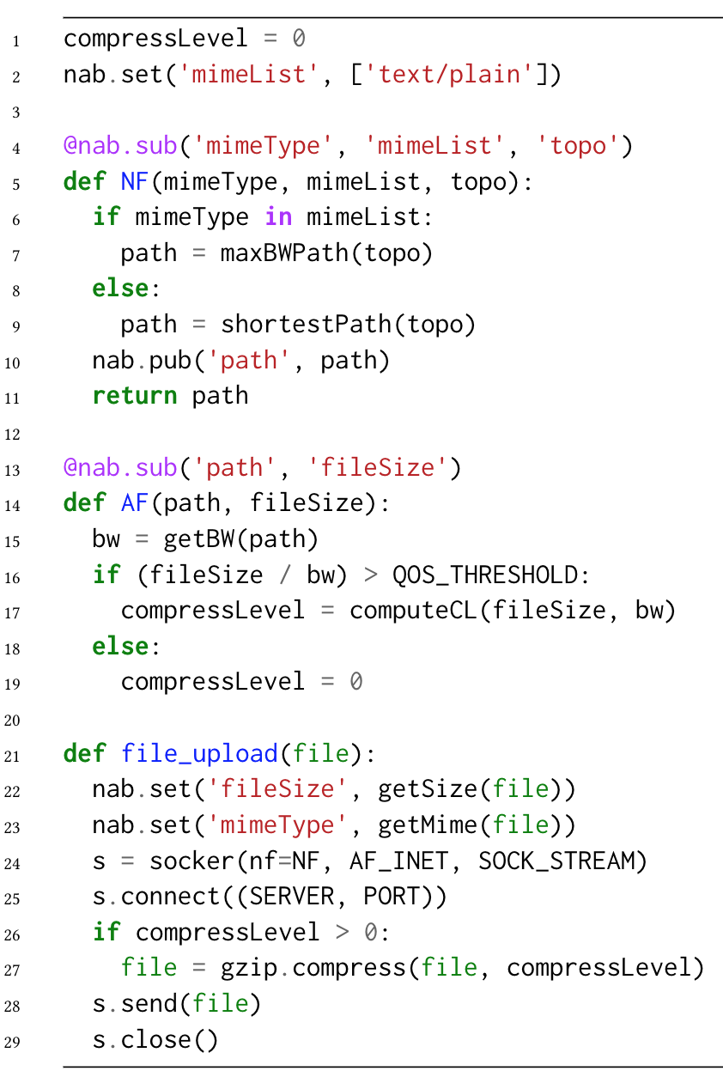
Example
Conventional socket program
Socker program
The handshake packets are already sent
No interaction between the application logic and the network logic
The burden of realizing network control
Notes:
Let’s see an example for comparation between the conventional socket program and the socker program. The code snippet on the left shows how the programmers achieve the goal of the motivating case using the conventional socket APIs in python, it applies the naïve idea that setup paths after the ephemeral port is returned. However, the program is buggy and deficient in functionalities. First, $to get the local port of the socket, in user space, we can only wait for the connect system call to return, but the TCP handshake packets are already sent in the connect process, therefore the handshake packets is out of control. $$Second, there is no interaction between the application logic and the network logic, since they only executed once and insensitive to the state change out of their execution scope. $$Thrid, because the program is entirely built on the user space APIs, and the user space APIs lack programmability on the data plane of the kernel, the programmers have the burden of realizing the network control, for example by interacting with the controller.

Slide 16
Example
Conventional socket program
Socker program
The NF is a function that specifies the desired actions (i.e., path) to the flow originated by the socket.
Separate into AF/NF
Creates a socket and specifies a NF.
Notes:
The code snippet on the right hand shows how socker achieve the goal of the motivating case. $ We separate the core logic of the program into AF and NF, the AF is responsible for adjusting the application logic, such as the compression level in our case. The NF is responsible for the network control, such as the routing path in our case. $$ we create a socket with the socker API and specifies a NF as one of the arguments, $The NF is a function that specifies the desired actions (for example a path) to the flow originated by the socket.

Slide 17
Socker APIs (NAB)
set(key, val)
Store a key-value pair to the NAB
unset(key)
Unset a key-value pair
pub(key, val)
Publish a key-value pair to the NAB and triggers the functions subscribing the key
@sub(key)
Decorate a function and auto-trigger the function when the value at key is published
Notes:
Another type of APIs provided by Socker are NAB APIs, $programmers can set or unset key-value pairs to the NAB. $For reactive programming, NAB provides the publish API that publishes a state change event and triggers certain functions subscribing the state, $the subscription process is achieved by a wrapper function, for example the decorator primitive of python, that register a function as an event listener, the decorated function will be automatically re-executed when any state of the subscribed variables change.

Slide 18
Example
Publish the actions (path) to NAB.
Subscribe the actions and trigger the AF which computes the compression level according to the bandwidth of the path and file size.
Store the file metadata to NAB.
Notes:
In the example, $we use the NAB APIs to store the file metadata which is consumed by AF and NF, $ in the NF, we publish the computed path to NAB which triggers the $AF that subscribe the path to compute the compression level.

Slide 19
Q: How does Socker execute the program?
Notes:
Given the program, then we present the execution workflow of Socker

Slide 20

Socker TCP Workflow
socker(NF)
User space
__sys_socket()
kprobe:sock_alloc_file(
struct socket *sock)
sp=sock->sk
ino=SOCK_INODE(sock)
sock* | inode
inode | route
hash | inode
Kernel space
sk2ino
ino2route
hash2ino
Notes:
We use the TCP process as an example to illustrate the workflow of Socker. $Socker maintains three eBPF maps in kernel, to bridge up the user space socket and kernel space socket, we use the inode number of the socket file descriptor as an intermediate variable. $When socker is invoked to create a socket, $libsocker starts a system call to the kernel to create socket. $Socker attaches an eBPF program to the sock_alloc_file system call, and traces the kernel socket structure pointer and its inode number

Slide 21
Socker TCP Workflow
socker(NF)
fd
ino=statFS(fd)
r=NF()
User space
__sys_socket()
kprobe:sock_alloc_file(
struct socket *sock)
sp=sock->sk
ino=SOCK_INODE(sock)
sock* | inode
sp | ino
inode | route
hash | inode
Kernel space
sk2ino
ino2route
hash2ino
Notes:
Then we store the mapping to the sock 2 inode map. $the socker API returns the file descriptor of the created socket to user space program, then libsocker queries the inode number using the file system API, and execute the NF,

Slide 22
Socker TCP Workflow
socker(NF)
fd
ino=statFS(fd)
r=NF()
connect()
User space
__sys_socket()
connect()
kprobe:sock_alloc_file(
struct socket *sock)
kprobe:tcp_connect(
struct sock *sk)
sp=sock->sk
H=hash(sk->5tuple)
ino=SOCK_INODE(sock)
ino=sk2ino.lookup(sk)
sock* | inode
sp | ino
inode | route
ino | r
hash | inode
Kernel space
sk2ino
ino2route
hash2ino
Notes:
the results are stored in the inode 2 route map. $ When the application calls the connect API, $which invokes the kernel connect system call, $Socker traces the kernel socket at tcp_connect system call where the ephemeral port is allocated but handshake packets are not sent, the eBPF program computes the hash value of the 5-tuple, and queries the sock 2 inode map to get the inode number

Slide 23
Socker TCP Workflow
socker(NF)
fd
ino=statFS(fd)
r=NF()
connect()
send()
User space
__sys_socket()
connect()
send()
kprobe:sock_alloc_file(
struct socket *sock)
kprobe:tcp_connect(
struct sock *sk)
SCHED_CLS:tc_egress(
struct __sk_buff *skb)
sp=sock->sk
H=hash(sk->5tuple)
H=hash(skb->5tuple)
ino=SOCK_INODE(sock)
ino=sk2ino.lookup(sk)
ino=hash2ino.lookup(H)
r=ino2route.lookup(ino)
sock* | inode
sp | ino
inode | route
ino | r
hash | inode
H | ino
encap(skb, r)
Kernel space
sk2ino
ino2route
hash2ino
Notes:
Then stores the mapping to the hash 2 inode map.$when the send API is called from user space, $$the ebpf program attached at the egress of traffic control is triggered. It queries the desired path from the eBPF maps, and applies to the socket buffer, in our example, we assume the network supports source routing, and encapsulate the packet with labels before emiting the packet to the network interface.

Slide 24
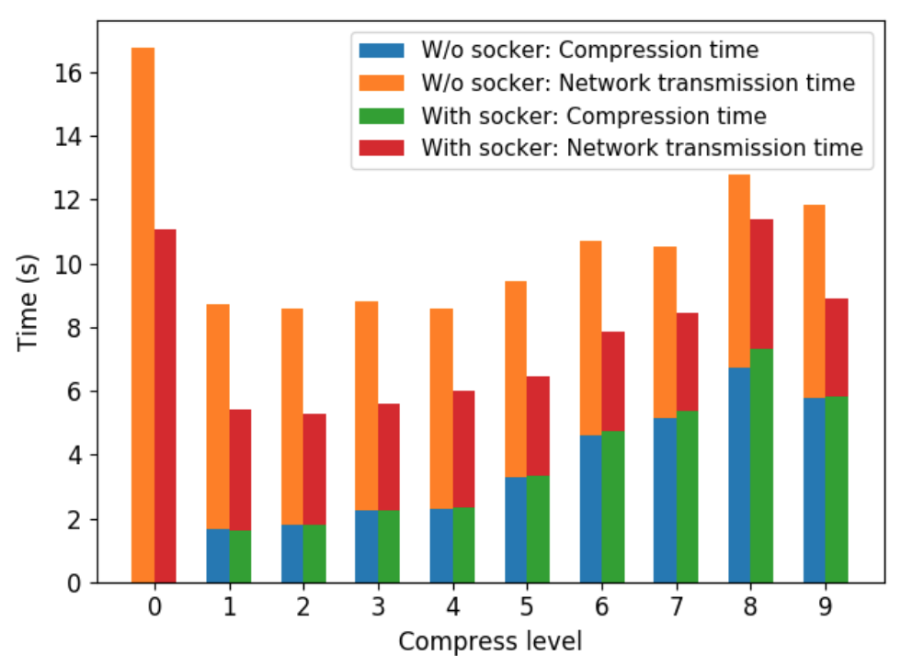
Evaluation Result
Total transmission time for an 100MB file
Compare the total transmission time between the conventional socket and Socker
Topology from the motivating case
100MB file from [1]
Python Gzip module with compression level 0~9
The shortest transmission time w/o Socker: 8.58s with compression level 2.
[1] Matt Mahoney. 2021. Large Text Compression Benchmark. http://mattmahoney.net/dc/text.html. (2021)
Notes:
In the evaluation, we demonstrate the effectiveness of Socker by Comparing the total transmission time between the conventional socket and Socker using the topology of the motivating case, we use the dataset from the large text compression benchmark and the python gzip module as a compressor. $The series of bars in the figure shows the total transmission time without Socker under different compression levels, $we see that the shortest transmission time is eight point fifty-eight (8.58 )seconds with compression level 2.

Slide 25
Evaluation Result
Total transmission time for an 100MB file [1]
Compare the total transmission time between the conventional socket and Socker
Topology from the motivating case
100MB file from [1]
Python Gzip module with compression level 0~9
Socker achieves 28.5% total transmission time reduction on average
The shortest transmission time with Socker is 5.29s with compression level 2
[1] Matt Mahoney. 2021. Large Text Compression Benchmark. http://mattmahoney.net/dc/text.html. (2021)
Notes:
In comparison, Socker achieves five point twenty-nine (5.29s) seconds of the shortest transmission time with compression level 2. $and twenty-eight point five percent (28.5%) total transmission time reduction on average. This is because socker can choose the max bandwidth path for the large file while the conventional socket uses the default shortest path.

Slide 26
Conclusion
Socker expresses the network control directly from end-host applications at socket level.
Socker obtains the dynamic flow attributes by tracing the sockets at run-time using eBPF.
Socker achieves dynamic reaction to AF and NF.
Future work:
Coordination of multiple AF/NF in the same network.
Prevent the cyclic state dependencies, e.g., static check/oscillation suppression by counters
Integrate more network protocols, e.g., QUIC.
Notes:
In conclusion, ($)socker is the First-ever framework to express the network control directly from end-host applications at socket level.
($)Socker Uses eBPF to trace the run-time states of the socket system calls to get the dynamic flow attributes and $ enables the network and application control to dynamically react to their states which may uncertainly change at runtime.
($) In the future, we will focus on the Coordination of multiple AF/NF in the same network. and handle the problem of dealing with millions of application flows. And prevent the cyclic state dependencies between AF and NF by static checking or use event counters to suppress the oscillation at runtime. Also, we will integrate more network protocols like QUIC, and provide easy-to-use libraries for network-application co-programming in future.

Slide 27
Thank you!
gd@tongji.edu.cn
Notes:
Thank you for your attention!

